Slide 1
Polarization
The polarization of light describes how the electric field in the Electromagnetic wave oscillates.

Slide 2
Unpolarized light
Natural light or ordinary light is unpolarized in nature. Means vibrations take place symmetrically in all directions in the plane perpendicular to the direction of propagation of light.

Slide 3
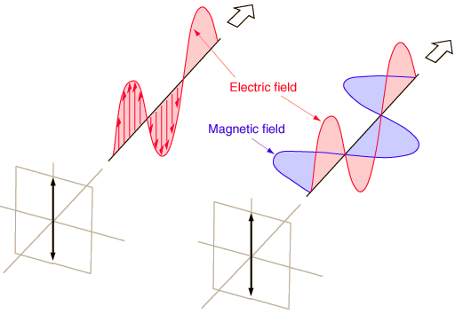
Polarization
Electric field only going up and down – say it is linearly or plane polarized.
The process of transforming unpolarized light into polarized light is known as polarization.

Slide 4
Polarization
Suppose light is propagating in x-direction Mathematically a plane polarized light can be represented as:

Slide 5
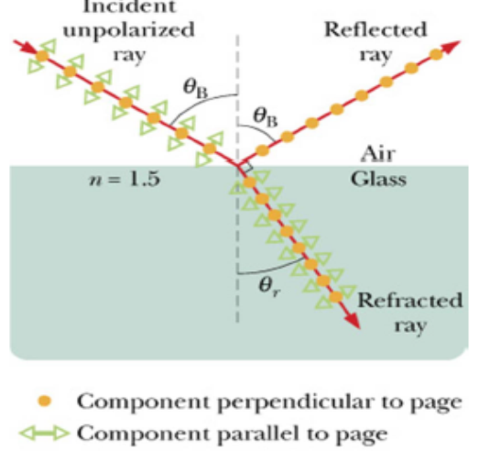
Polarization by Reflection
In 1881 Brewster on the basis of his experimental observations discovered that when unpolarized light is incident at polarizing angle on the dielectric medium the reflected light is completely plane polarized.
The polarizing angle is different for different reflecting surfaces.

Slide 6
Polarization by Reflection
When the refracted ray is perpendicular to the reflected ray, the electric field parallel to the page (plane of incidence) in the medium does not produce a reflected ray since there is no component of that field perpendicular to the reflected ray (EM waves are transverse).

Slide 7
Polarization by Reflection

Slide 8
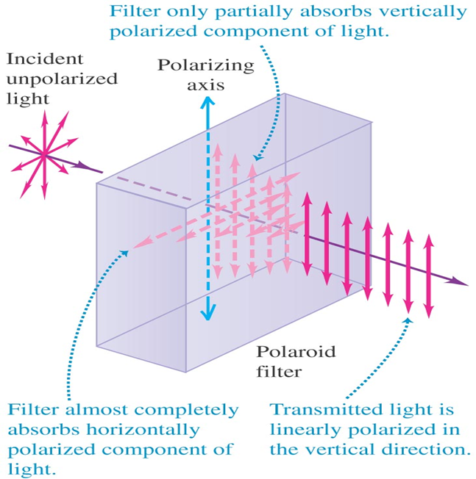
Polarization by Absorption
Polarization can also be achieved by passing the light through a substance that absorbs light vibrating in all directions except one.
Anisotropic crystals have this property in certain directions, called privileged directions.
The device used to make polarized light in modern microscopes is a Polaroid, a trade name for a plastic film made by the Polaroid Corporation.

Slide 9
Polarization by Absorption
A Polaroid consists of long-chain organic molecules that are aligned in one direction an placed in a plastic sheet.
They are placed close enough to form a closely spaced linear grid, that allows the passage of light vibrating only in the same direction as the grid.
Light vibrating in all other directions is absorbed. Such a device is also called a polarizer.

Slide 10
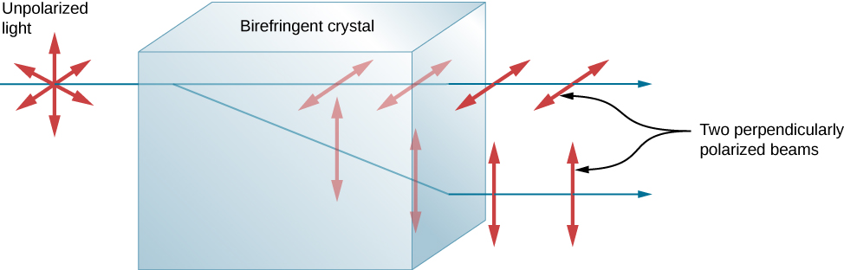
Polarization by Birefringent Crystals
Another interesting phenomenon associated with polarized light is the ability of some crystals to split an unpolarized beam of light into two polarized beams.
This occurs because the crystal has one value for the index of refraction of polarized light but a different value for the index of refraction of light polarized in the perpendicular direction, so that each component has its own angle of refraction.

Slide 11
Polarization by Crystals
Such crystals are said to be birefringent, and, when aligned properly, two perpendicularly polarized beams will emerge from the crystal.
Birefringent crystals can be used to produce polarized beams from unpolarized light.
Some birefringent materials preferentially absorb one of the polarizations. These materials are called dichroic and can produce polarization by this preferential absorption..

Slide 12
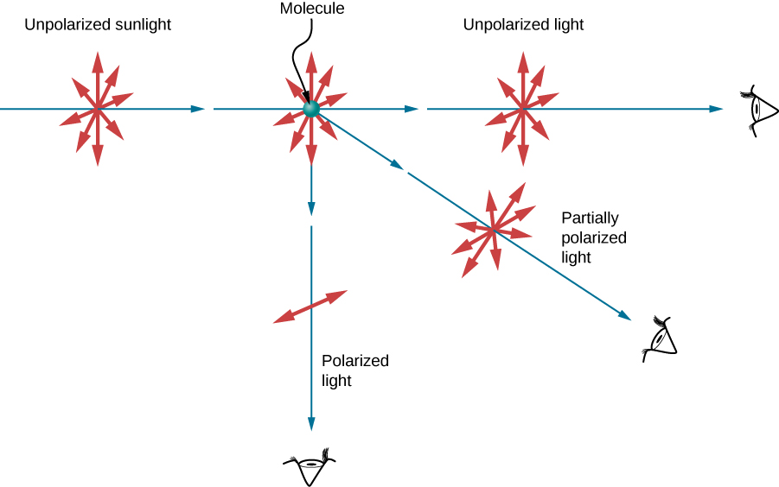
Polarization by scattering
Unpolarized light scattering from air molecules shakes their electrons perpendicular to the direction of the original ray. The scattered light therefore has a polarization perpendicular to the original direction and none parallel to the original direction.

Slide 13
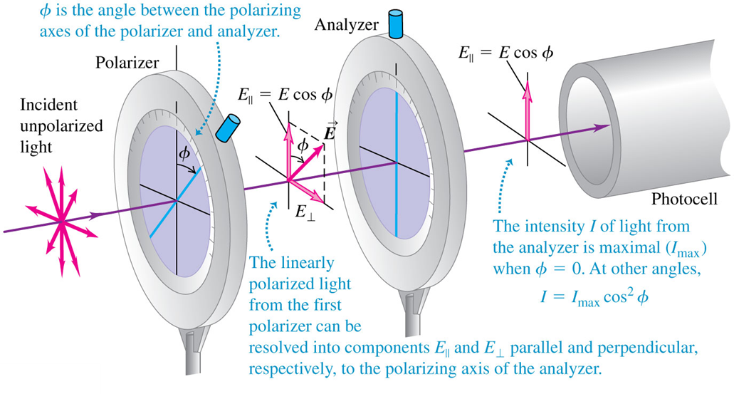
Malus’s law

Slide 14
Malus’s law
A second polarizer (the analyzer) at angle φ relative to the first further reduces the intensity according to:
Malus’s law: I = I_{max}cos²φ.
A polarizer reduces the intensity of unpolarized light (I₀) by a factor of 2, so the intensity of transmitted light is I₀/2.
Since only the component of the incident electric field E parallel to the polarizing axis is transmitted.

Slide 15
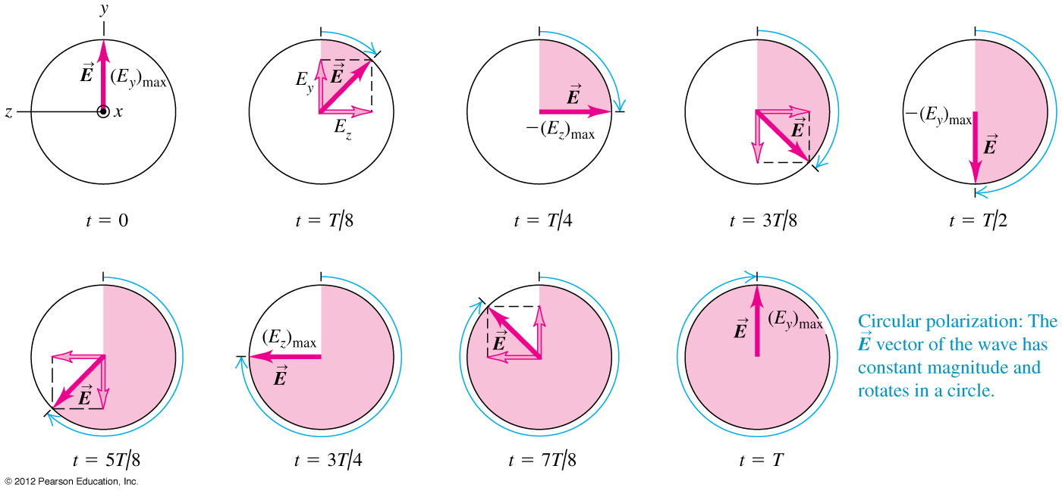
Circular polarization
Circular polarization results from the superposition of two perpendicularly polarized electromagnetic waves having equal amplitude but a quarter-cycle phase difference. The result is that the electric field vector has constant amplitude but rotates about the direction of propagation.

Slide 16
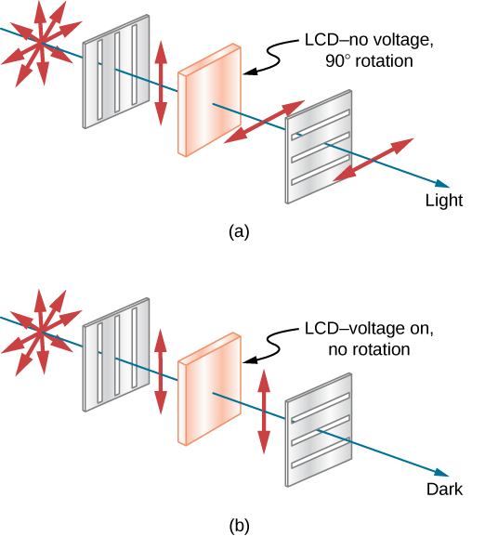
Liquid Crystal Display
Liquid crystals are so named because their molecules can be aligned even though they are in a liquid. Liquid crystals have the property that they can rotate the polarization of light passing through them by 90°.
Furthermore, this property can be turned off by the application of a voltage.
It is possible to manipulate this characteristic quickly and in small, well-defined regions to create the contrast patterns we see in so many LCD devices.

Slide 17

Removing reflection using polarizing filter Polaroid cameras

Slide 18
3D movies - any polarization involved ?

Slide 19
3D movies - any polarization involved ?
A polarized 3D system uses polarization glasses to create the illusion of three-dimensional images by restricting the light that reaches each eye
To present stereoscopic images and films, two images are projected superimposed onto the same screen or display through different polarizing filters.
The viewer wears low-cost eyeglasses which contain a pair of different polarizing filters. As each filter passes only that light which is similarly polarized and blocks the light polarized in the opposite direction, each eye sees a different image.
This is used to produce a three-dimensional effect by projecting the same scene into both eyes, but depicted from slightly different perspectives.

